Slide 1
OceanStor 100D NAS Product Overview
Boston Storage Solution Group

Slide 2
Core storage requirements
Product quick introduction
Product spec comparison
Overview
Software
OceanStor 100D
Enterprise NAS
Hardware
Enterprise Features

Slide 3
OceanStor 100D vs Core Storage Requirements
Scalability
Huawei OceanStor 100D (originally called FusionStorage) is an intelligent, distributed storage product with scale-out architecture to support the business needs of both today and tomorrow.
High scalability: Scale-out architecture supports up to 4096 nodes.
High performance: High performance based on specially designed hardwares and many software features.
High Reliability: Designed for core enterprise systems. 100D supports fast failover and failback.
Low cost: Off-the-shelf servers or specialized nodes. Customers can pick best fit nodes and mix them. Tiering is supporting to provide best TCO.
High usability: One cluster provides industry standard interfaces, such as block, HDFS, object, and file storage, for upper-layer applications. This greatly simplifies operations complicated by siloed storage systems.
Usability
Performance
Customers’
Core Requirements
Reliability
Cost

Slide 4



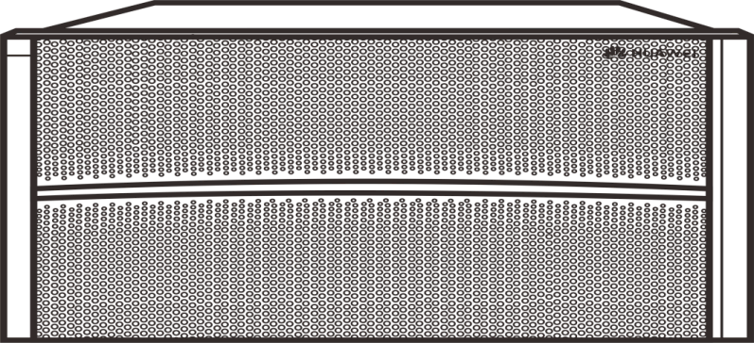


OceanStor 100D NAS Quick Introduction
Expansion by adding disks
(4 -> 36 per node)
Expansion by adding nodes
(3 -> 4096 per system)
App 1
App 2
App N
…
…
…
Elastic supply of on-demand storage resources
Expansion by adding cabinets
(3 -> 12 per resource pool)
Expansion by adding storage pools
(1 -> 128 per system)
OceanStor 100D distributed storage resource pool
…
OceanStor 100D NAS provides single name space resource pooling for multiple applications.
Its scale-out architecture allows flexible expansion up to 4096 nodes.

Slide 5
OceanStor 100D NAS Product Spec Comparison
 | OceanStor 100D NAS | Competitor Product
Form Factor | Fit in standard 1m rack | 1.1-1.2m depth requires proprietary rack
Power density per 4U | 790w-1200w (depends on configuration) | Around 1500w
Max capacity in 5kw rack | 3024TB (6 node cluster) | 1440-2400TB (depends on model)
Max capacity in 8kw rack | 5040TB (6 node cluster) | 2400-4000TB (depends on model)
Max capacity per FS | 200PB | 17.2-28.8PB (depends on model)
Front end speed | 10/25/40/100GE / Infiniband | 10GE for low end, 10/40GE for high end
Backend speed | 25/40/100GE / Infiniband | 10/40GE (Latest model has no IB support)
Rebuild speed | 2TB/hour (HDD) | < 0.25TB/hour (HDD)
Drive replacement | Performed individually | Requires pulling whole sled

Slide 6
Overview
Software
OceanStor 100D
Enterprise NAS
Hardware
Enterprise Features
Architecture overview
Deployment overview
Deployment comparison
Specialty hardware
Scale out overview
Scalability comparison

Slide 7
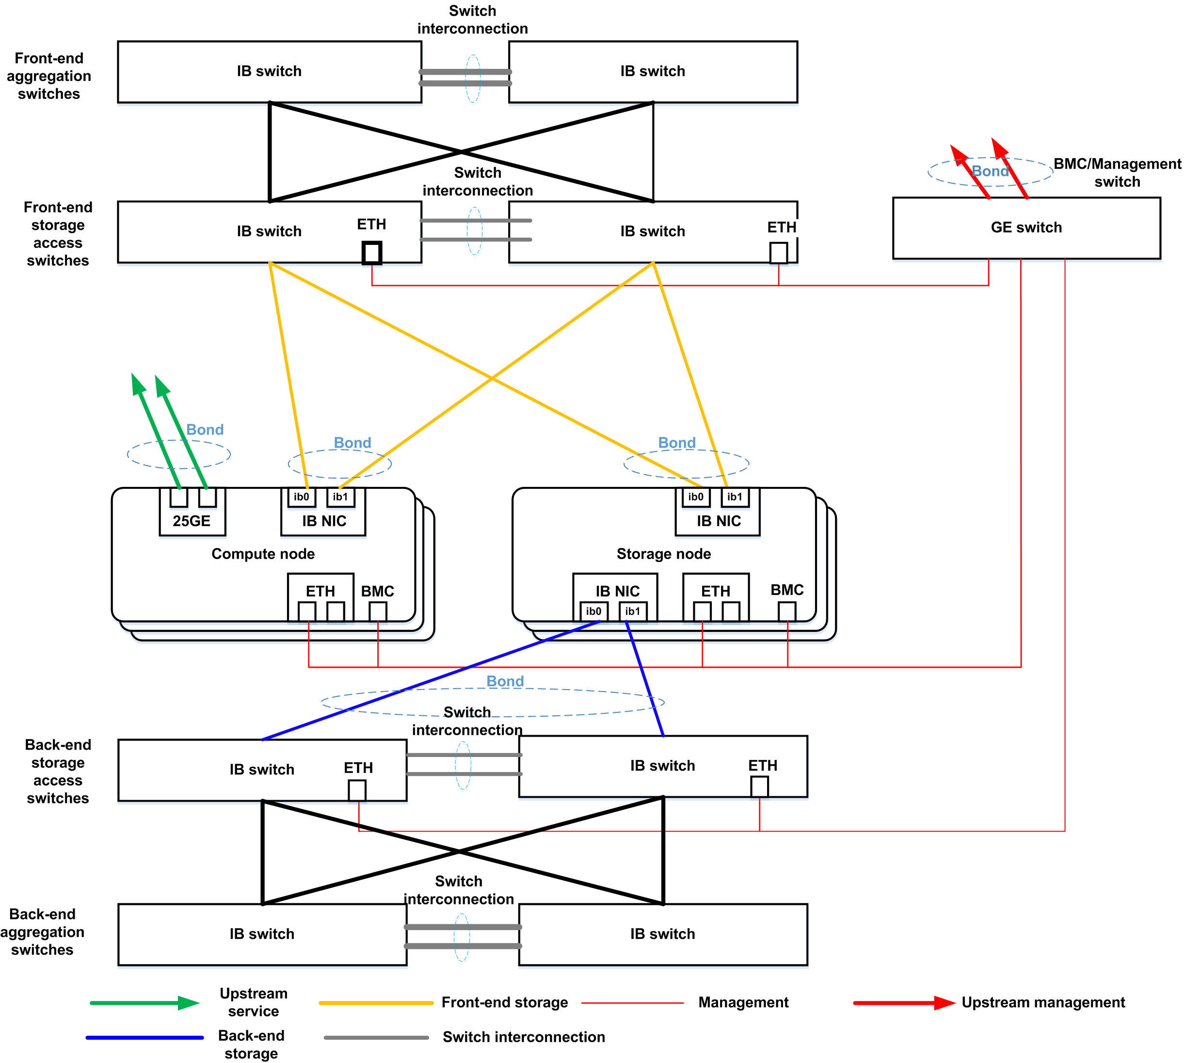
System Hardware Architecture Overview
Huawei 100D NAS storage system features a fully symmetric distributed architecture with component level failover.
Extensive scale-out capabilities support up to 4096 nodes in one cluster, and single FS up to 256 nodes and up to 200PB. (TODO: to be verified)
Bleeding edge technology integration – RDMA, NVME, 40/100GE
Superior performance in a super-large single file system up to 200PB for shared storage of unstructured data, accessible through multiple front end protocol including File (NFS, SMB) and Object (HDFS, S3) on one copy of data.
Independent deployment, where front- and back-end storage networks are separated

Slide 8

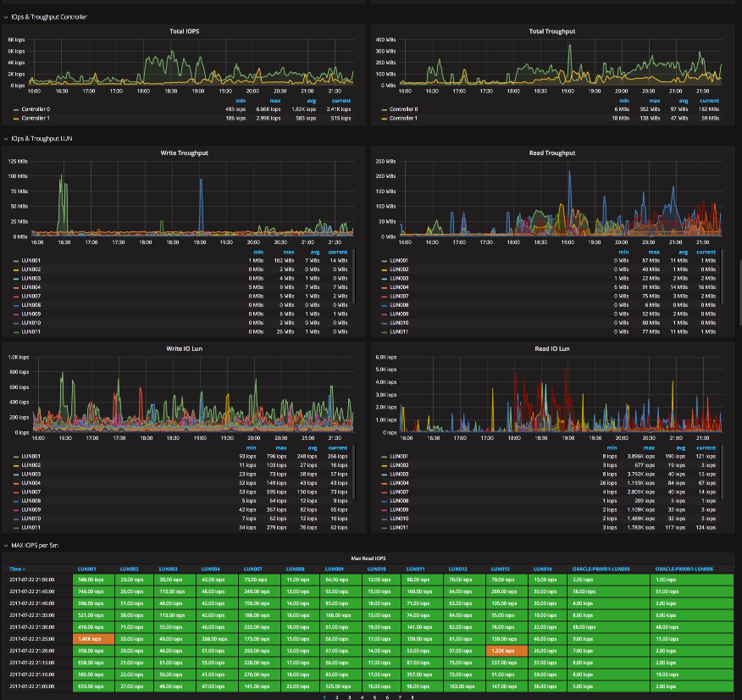
OceanStor 100D NAS Deployment Overview
Integrated software and hardware, simplified deployment and management.
Most flexible scaling options with rich selection of hardware optimized for many typical scenarios.
One stop software upgrade and maintenance.
Fully unified and visualized management makes planning, deploy and monitoring easy.
Comprehensive real-time monitoring and AI assisted prediction matrix.
Ansible and REST support works with many mainstream automated deploy and management framework.

Slide 9
OceanStor 100D NAS Deployment Comparison higher density, better performance
 | OceanStor 100D NAS | Competitor Product
Cluster size flexibility | 3-4096 nodes | 3 or 4-252 nodes (depends on model)
Expansion restriction | No restriction, can add 1 node at a time | Must expand at least 2 nodes
Hardware monitoring | SystemReport software included for free | Extra software license required with additional cost
Network switch management | Integrated backend switch management | NA
Capacity density | Up to 1.6PB/5U (pacific node) 24 disk slots / 1U | Around 0.5PB/4U
Rack capacity | Up to 6 Pacific chassis with capacity up to 9.6PB in 42U rack | Up to 9 chassis with capacity up to 6PB

Slide 10
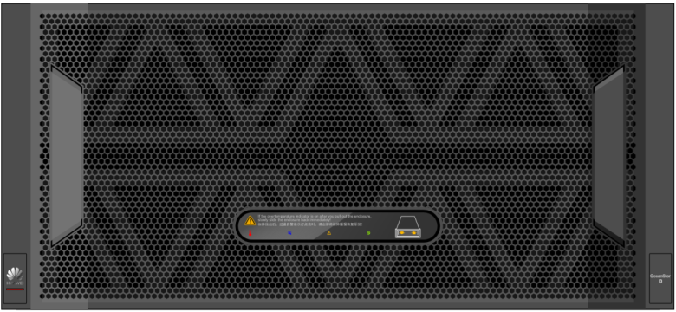
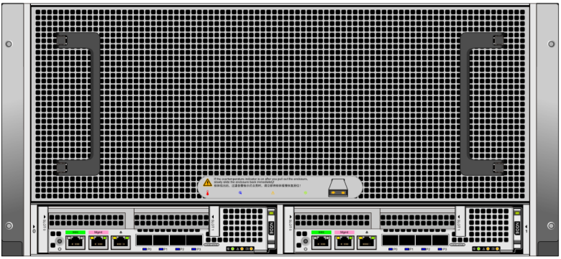
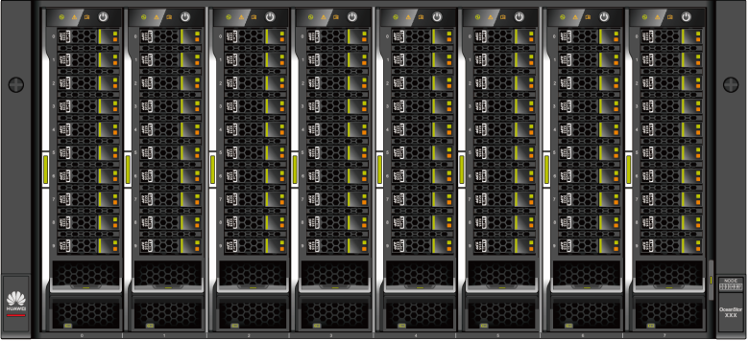
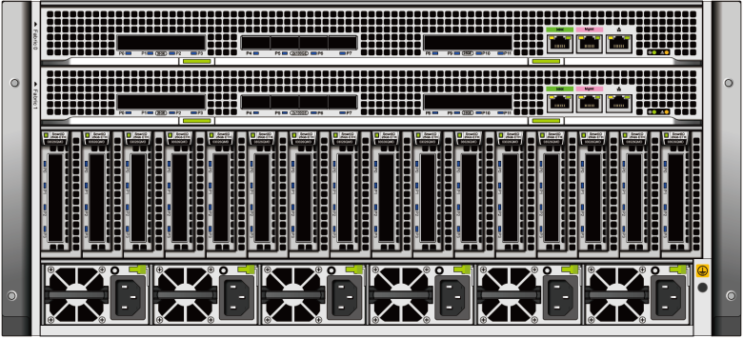
OceanStor 100D Specialty Hardware Optimized for high capacity or high performance
Front view
Rear view
In addition to generic commodity server hardware, OceanStor 100D also offers rich selection of specialty hardware that is optimized for different business scenarios.
Pacific Hardware: High Disk Density, Ultimate TCO, Dual-Controller Switchover, High Reliability, Smooth Data Upgrade, and Ever-New Data.
Atlantic Hardware: Flash Storage Native Design with Ultimate Performance, Built-in Switch Networking, Smooth Upgrade, and Ever-New Data.
High-density HDD
(Pacific)
5 U, 2 nodes, 60 HDDs per node, 120 HDDs in total
Two I/O cards per node, four onboard 25GE ports
High-performance all-flash
(Atlantic)
5 U, 8 nodes, 10 SSDs per node, 80 SSDs in total
Two I/O cards per node, a total of 16 I/O cards. Two switch boards, supporting eight 100GE ports and eight 25GE ports

Slide 11
OceanStor 100D NAS Scale Out Overview
OceanStor 100D NAS has outstanding scalability in scale out, far superior than major competitors. Here is a quick architecture overview:
Compute
cluster
Adding/Reducing compute nodes
Compute node
Compute node
Compute node
Compute node
Compute node: 10,240 nodes supported by TCP, 100 nodes supported by IB, and 768 nodes supported by RoCE
VBS
VBS
VBS
VBS
Network switch
Storage node
Storage node
Storage node
Storage node
Storage node
Control
cluster
Adding/Reducing ZK disks
ZK
ZK
ZK
ZK
ZK
3-9 ZK modules can be deployed per cluster
Storage
pool
Adding/Reducing storage nodes
Disk
Disk
Disk
Disk
Disk
Disk
Disk
Disk
Disk
Disk
Storage node: node/cabinet-level capacity expansion, up to 4096 nodes
Adding/Deleting nodes in the existing storage pool or creating new storage pool
Disk
Disk
Disk
Disk
Disk
Adding disks
Disk
Disk
Disk
Storage node: on-demand disk expansion

Slide 12
OceanStor 100D NAS Scalability Comparison
 | OceanStor 100D NAS | Competitor Product
Max #nodes per cluster | 4096 | 252
Max #cores per node | 96 cores (2x Kunpeng 920) / 2x XEON | 1x XEON
Max RAM size per node | 512GB (16X32GB DDR4) | 16/64/128/256/384GB depends on model
Max capacity per FS | 200PB | 17.2-66PB (depends on model)
Max front end speed | 100GE / Infiniband w/ RDMA | 10GE for low end, 40GE for high end
Max backend speed | 100GE / Infiniband w/ RDMA | 40GE (Latest model has no IB support)
Max throughput per node | 2.9GBps read, 2.9GBps write | 1.25GBps read, 0.65GBps write
Max throughput per stream | 2.5GBps for both r/w when using private client (DPC) | 0.4-1.8GBps for read depends on media, less for write

Slide 13
Software architecture
Access protocols
Performance
Distributed cache
Erasure coding (EC)
Rebuild
Deduplication & compression
Overview
Software
OceanStor 100D
Enterprise NAS
Hardware
Enterprise Features

Slide 14
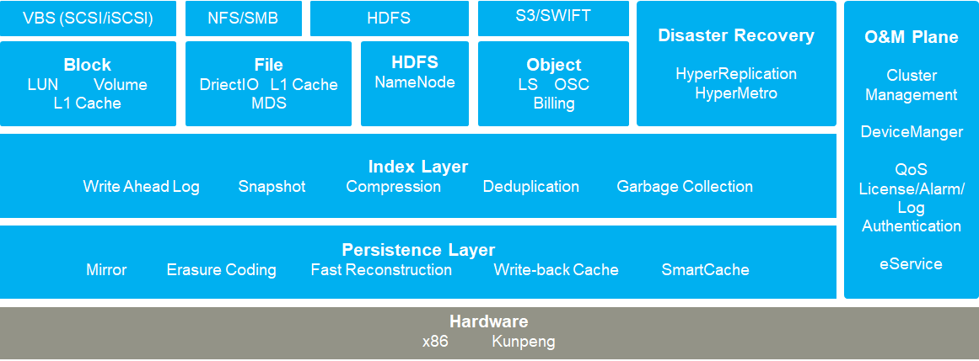
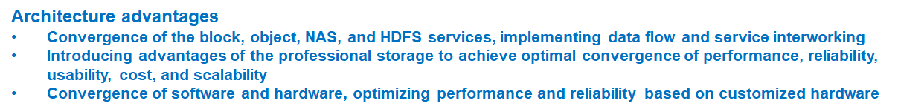
OceanStor 100D NAS Software Architecture Overview

Slide 15





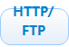




Competitor Product Software Architecture
Scale-out NAS Architecture, combining file system, volume manager and data protection.
OS: built on BSD-based UNIX OS foundation;
File system: based on UNIX file system (UFS), one namespace each cluster;
Three-layer caches:
L1 RAM cache: global shared cache, aggregating the cache on each node. It uses MESI-like protocol (using distributed locks) for cache coherency.
File-level data protection with EC and mirroring. The nodes and disks are grouped into clusters->tiers->node pools->disk pools.

Slide 16
Shared Nothing Architecture
 | OceanStor 100D NAS (Shared Nothing) | Competitor Product
Frontend | Sharded based on characteristics of IOs | Fully shared
Load balancing | Great | Depending on configurations
Scalability | Highly scalable(4k) | Less scalable(252)
Metadata | Sharded | Centralized metadata, requires costly locking
Locking | No need complex distributed lock for most operations | Need complicated 2PC to coordinate NAS transactions
Caching | Easy to maintain cache coherency | Use MESI
Transaction | Only needed for limited operations (such as rename) | 2PC For all non-read operations.
Performance | Suitable for all workload | Only for large file not for small or metadata heavy operations
Cluster management | Easy to manage, Hierarchical MDS with ZK | Require simple quorum

Slide 17
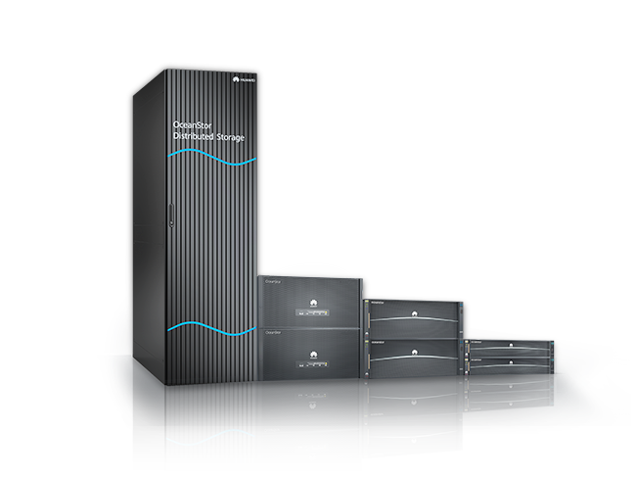


OceanStor 100D NAS Multi-Protocol Access
NFS
Multiple access protocols to access a single copy of data.
File/ Object/ HDFS
Adapt to major applications for semi-structured and unstructured data
Private client is available for high performance, supporting advance features that is impossible with generic file protocol such as RDMA, MPI
Single copy of data
CIFS
HDFS
FTP
S3
Private
Client access

Slide 18
File Access Protocol Comparison
File Protocol | OceanStor 100D NAS | Competitor Product
NFS | V3 / V4(roadmap) | V3 / V4
SMB | V2/V3 | V2/V3
HDFS | Yes | Yes
FTP | Roadmap | Yes
HTTP | Not integrated, can be offered through a gateway node | Yes
S3 | Yes | Yes (limited function, need more details)
Private Client | Yes (offers advanced features such as RDMA and MPI) | No
Multi-protocol on 1 copy of data | Yes (native access for all protocols) | Yes (not native access for non-file protocols)

Slide 19
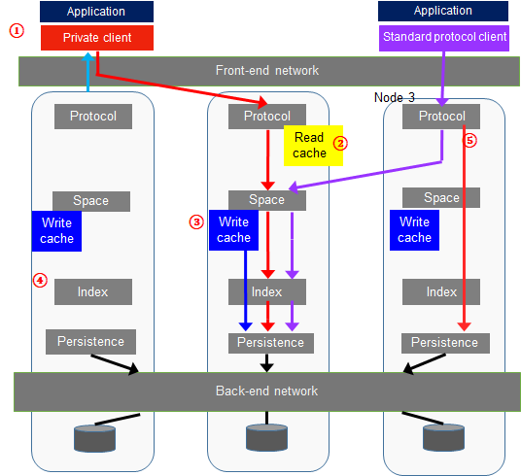
Performance Comparison
Key Technology | Large Files, High Bandwidth | Large Files and Random Small I/Os | Massive Small Files, High OPS | Peer Vendors
1. Private client (POSIX, MPIIO) | Multi-channel protocol 35% higher bandwidth than common NAS protocols | Intelligent protocol load balancing 45% higher IOPS than common NAS protocols | Small I/O aggregation 40% higher IOPS than common NAS protocols | Vendor D and vendor N do not support this function. Vendor DD and vendor I support this function.
2. Intelligent cache | Sequential I/O pre-read improves bandwidth. | Regular stream prefetch improves the memory hit ratio and performance and reduces the latency. | I/O workload model of intelligent service learning implements cross-file pre-reading and improves the hit ratio. | Peer vendors support only sequential stream pre-reading and do not support interval stream pre-reading or cross-file pre-reading.
3. NVDIMM | Stable write latency | Stable write latency and I/O aggregation | Stable write latency and file aggregation | Only vendor D and vendor N support this function.
4. Block size of the self-adaptive application | 1 MB block size, improving read and write performance | 8 KB block size, improving read and write performance | 8 KB block size, improving read and write performance | Only Huawei supports this function.
5. Large I/O passthrough | Large I/Os are directly read from and written to the persistence layer, improving bandwidth. | / | / | Only Huawei supports this function.

Slide 20
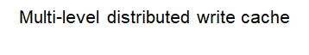
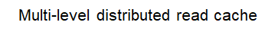
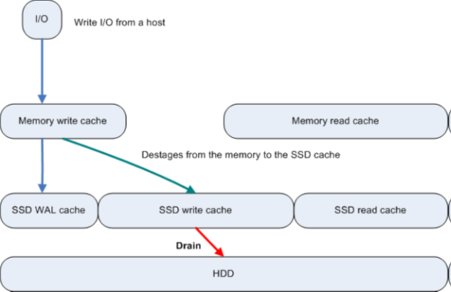
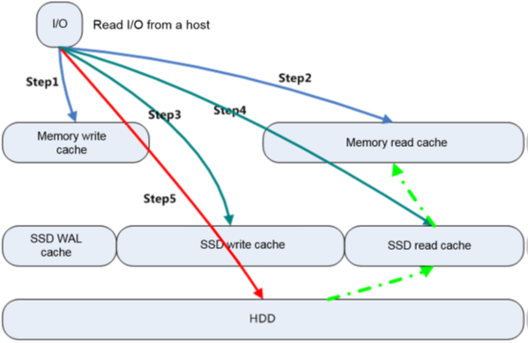
Distributed Cache Overview
Distributed non-shared cache
Various hotspot identification algorithms: Sequential IO prefetch, Regular stream prefetch, interval stream pre-reading or cross-file pre-reading, I/O workload modeling.

Slide 21
Competitor Product Cache Design
Write cache operations:
1. An NFS client sends initiate node a write request for a file with +2n protection.
2. initiate node accepts the write into NVRAM write cache and mirrors to participant nodes’ log files.
3. Write acknowledgement is returned to the client.
4. As Node 1’s write cache fills, it is periodically flushed, and writes to disks with EC.
5. The write cache and participant log files are cleared.
L1 Cache
RAM, global shared
Client side
Write
Cache
NVRAM
L2 Cache
RAM, local
backend
Read cache operations:
On local node:
1. Determine whether the data is in L1 cache, if so, return to client.
2. If not, request data from remote nodes.
On remote nodes:
1. Determine whether the data is in the L2 or L3 cache.
2. If not in the local caches, read from disk and return data to initiate node.
L3 Cache
SSD, local
backend
L1 cache: global shared, uses MESI protocol (using distributed locks) for cache coherency.
NVRAM cache: journal cache
Real-time adaptive prefetch (per file)

Slide 22
Cache Comparison non-shared, intelligent prefetching and hotspot identification
OceanStor 100D NAS | Competitor Product
Memory cache is distributed (non-shared) without lock mechanism. File is evenly distributed to all nodes based on directories. | L1 cache is globally shared with distributed lock mechanism.
Data writes do not transaction, except certain cases. | Write uses two-phase commit transaction, which is slow and inefficient.
Intelligent prefetching (including cross-file prefetching) and hotspot identification algorithms. | Only per file prefetch is supported.
Large IO passthrough | Large IO passthrough not supported.

Slide 23
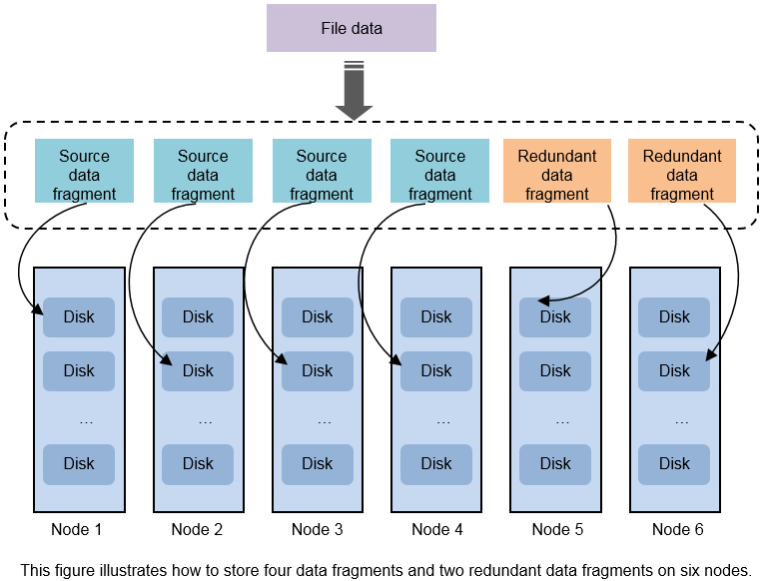
Elastic EC features
Node-level and cabinet-level security: In the EC mode, different data/parity fragments are distributed on different nodes/cabinets.
EC expansion: As the number of nodes increases during capacity expansion, the number of data blocks automatically increases, with the reliability unchanged and space utilization improved.
EC reduction: When nodes are faulty and the number of normal nodes does not meet the minimum quantity required by an EC scheme, users can reduce data fragments to ensure that the reliability is not reduced.
EC aggregation + append-only write: aggregates small IOs into full EC stripes. Append only write changes random write to sequential write. This improves write efficiency.

Slide 24
Erasure Coding Comparison Better algorithm, higher efficiency
OceanStor 100D NAS | Competitor Product
Home-developed encoding/decoding algorithm with higher efficiency and less CPU usage. | Reed-Solomon codes
EC expansion and reduction | The level of redundancy can be changed in real time.
EC aggregation improves storage efficiency and reduces write amplification. | Small file cannot be aggregated during write, using multi-copy. Shadow stores are used to packing small files in background.
8KB block size for small file or random small IOs. 1MB block size for large files to improve performance. Small files are aggregated to improve efficiency. | 8KB block size. A file smaller than 8KB will use a full 8KB.
User selects protection level when storage pools are created. Support maximum 22+2 or 20+4 EC scheme. (22 +2 is 92% storage efficiency). Large scale storage pools with higher efficiency (%15 higher). | Maximum of 4 node failure in a node pool. Each node pool is devided into several disk pools. Disk pools are protected at +2d:1n (two disk failure or one node failure) by recommendation. (8+2 EC is 80% storage efficiency)
Node-level and cabinet-level fault domain | Sled-level, Node-level and chassis-level fault domain.
Disk failure prediction | No disk failure prediction
Notes:
Each chassis contains 4 nodes, 4 compute modules (one per node) and file drive sleds per node.
The nodes and disks are grouped into clusters->tiers->node pools->disk pools.
Support +1n, +2d:1n, +2n, +3d:1n, +3d:1n1d, +3n, +4d:1n, +4d:2n, +4n EC protection level. Support 2x to 8x mirroring.
+1n: means 1 n(ode) failure.
+2d:1n means 2 d(isk) or 1 n(ode) failure. In this case, each protection group has 2 disks on each node.

Slide 25
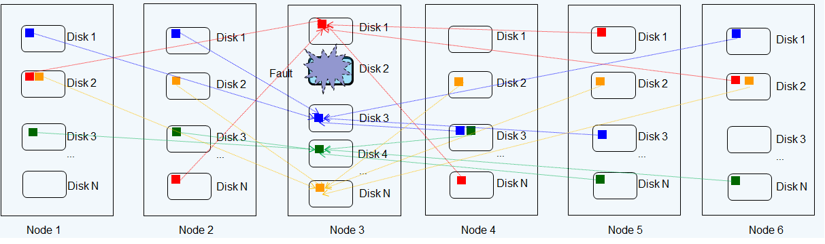
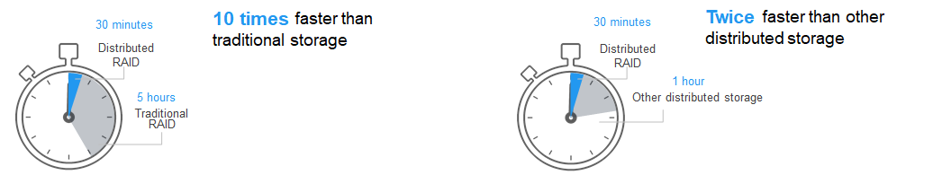
Rebuild Comparison
OceanStor 100D: partition based
Each disk belongs to several partitions. Each partition rebuilds to different disks/nodes.
Competitor Product: file based
When a drive fails, the system determines which files are affected by reading inode data off disk. The set of affected files are assigned to a set of worker threads that are distributed among the cluster nodes. The worker nodes repair the files in parallel.

Slide 26
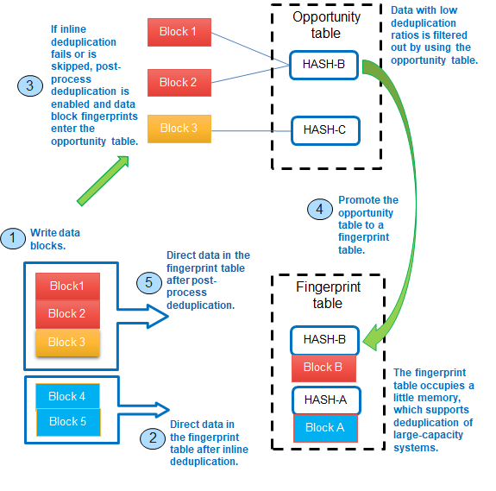
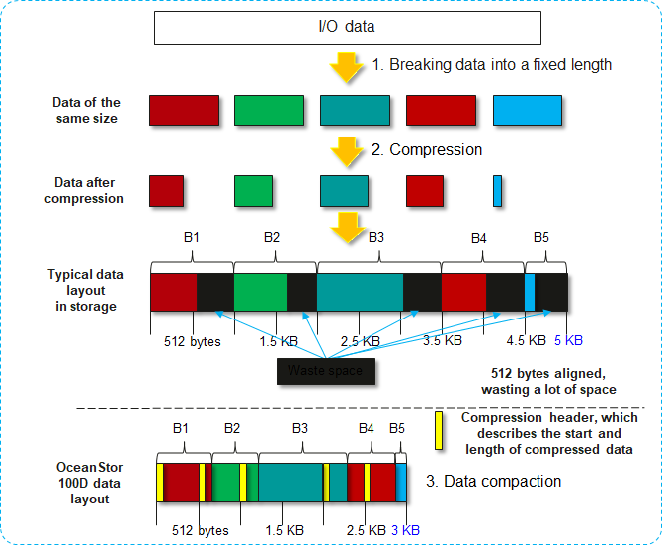
Dedupe/Compression
deduplication
compression

Slide 27
Deduplication/Compression Comparison Adaptive inline/post-process deduplication, higher compression rate
Feature | OceanStor 100D NAS (Roadmap) | Competitor Product
Inline/post-process deduplication | Supports inline and post-process deduplication | Supports post-process deduplication. Inline deduplication is supported on certain platforms.
Adaptive deduplication | The self-adaptive deduplication technology automatically switches between inline and post-process deduplication based on service loads | No adaptive feature.
Memory consumption | OceanStor 100D uses the opportunity table and fingerprint table mechanism. The opportunity table is used to reduce invalid fingerprint space. | Fingerprints occupy a lot of memory. Inline process uses a lot of CPU resource which impact performance.
Compression algorithm | The compression engine runs in a combination of two different compression algorithms (LZ4 and HZ9), to balance between performance and compression rate. | Hardware compression engine uses zlib for some platforms, with a software implementation of igzip for other platforms.
Data compaction | After compression, data blocks less than 512 bytes can be compacted, and then stored and aligned in the storage space. | Compression chunk is usually 128KB, 8K aligned. Efficiency savings must be at least 8KB for compression to occur.

Slide 28
Overview
Software
OceanStor 100D
Enterprise NAS
Hardware
Enterprise Features
Snapshot
Async replication
Tiering
Quota
WORM feature
Anti-virus feature
NDMP backup

Slide 29
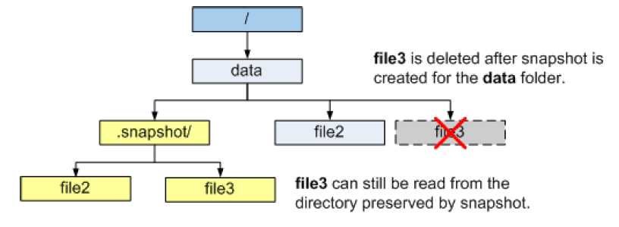
Snapshot (InfoStamper)
Support directory level snapshot.
Support dtree level snapshot with overlapping.
Maximum 2048 snapshots per directory.
Snapshot frequency: Snapshots can be created at an interval of 1 second.
Manual snapshot, periodic snapshot (by day, week, or month)
A maximum of six snapshot policies can be configured for a single directory.
Expired snapshots will be automatically deleted.

Slide 30
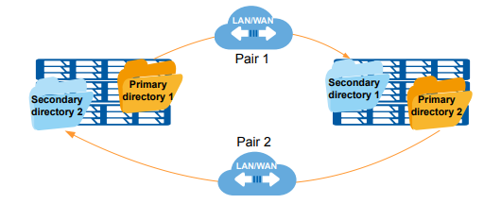
Asynchronous Replication (InfoReplicator)
Production center
Remote DR center
Asynchronous replication provides 99.999% solution-level reliability.
An asynchronous remote replication relationship is established between the production center and a secondary DR center.
After the initial synchronization is complete, the asynchronous remote replication enters the periodic incremental synchronization phase. Based on the customized interval, the system periodically starts the synchronization task and synchronizes the incremental data written by the production host from the end of the previous period to the current time.
Support for one-to-one and one-to-many
Simple management and one-click DR drill and recovery
WAN
Asynchronous replication
Roadmap

Slide 31
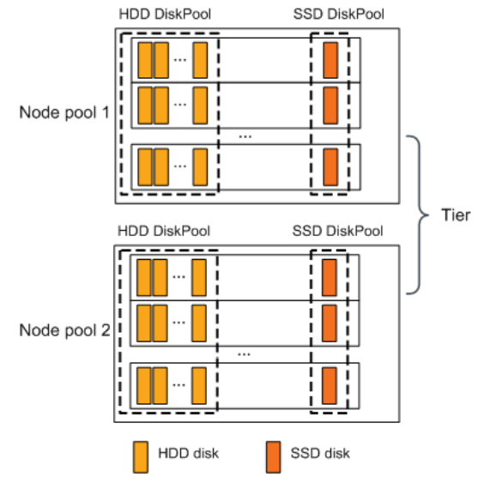

Tiering (InfoTier)
Roadmap: support tiering to cloud
Data location can be optimized based on context such as creation time, file size, modified time, I/O hotness, etc.
Data flow among tiers
Policy based strategy

Slide 32
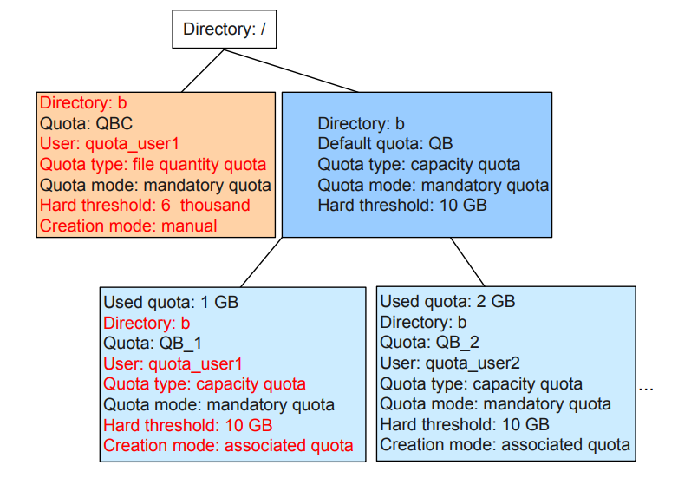
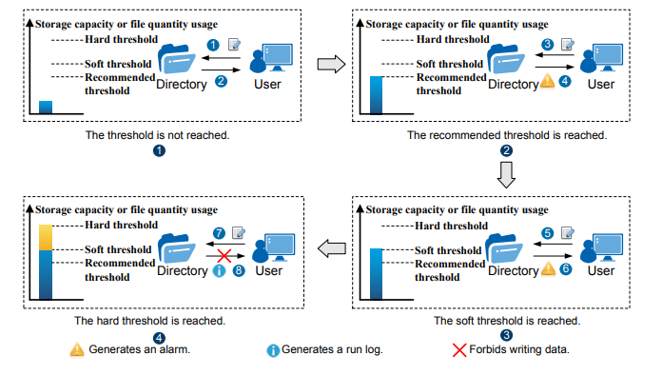
Quota (InfoAllocator)
Multiple quota types such as file quantity and capacity.
Different thresholds
Statistics

Slide 33

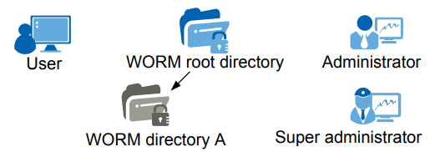
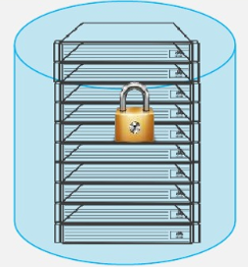
WORM (InfoLocker)
When data is in protection, data cannot be modified or deleted.
Expired files can be deleted but cannot be modified.
Support individual WORM clock. Cannot be modified after setup.
Subdirectory will inherit the WORM attributes of the father directory.
The super administrator (admin) can execute the privileged deletion of files, empty files, WORM root directories in the Protected state.
Roadmap

Slide 34
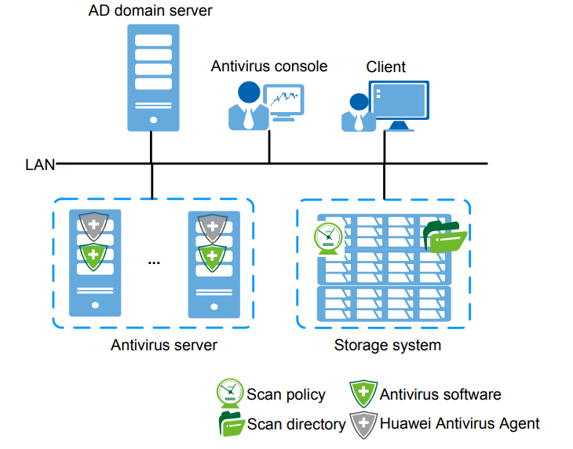
Virus Scan (InfoScanner)
Anti-virus software is downloaded via Device Manager, 100D’s management software.
Anti-virus software is installed on the antivirus server.
The files to be scanned are sent to the antivirus server.
Online and periodic scan mode.
Multiple anti-virus software supported.
Roadmap

Slide 35
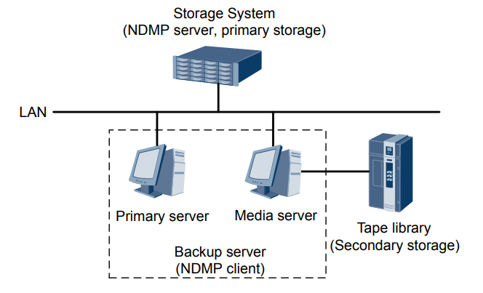
Network Data Management Protocol (NDMP)
Network Data Management Protocol (NDMP)
Multiple modes:
Snapshot-based backup
Source directory-based backup
Full and differential backup
Roadmap

Slide 36
Enterprise Feature Quick Comparison
Features | OceanStor 100D NAS | Competitor Product
Snapshot | Directory level Snapshot (2048 snapshots per directory) at dtree level with overlapping support. COW and ROW-based. Support snapshot policy. | Directory level Snapshot (e.g., 1024 snapshots per directory)
Replication | Policy based asynchronous replication with directory level. One to one, one to many, many to one, and two-way replication. RPO can reach 60 seconds. | Similar functionalities. RPO can reach 5 minutes. Continuous data protection mode to simulate synchronous replication.
Tiering | Automatic tiering and batch move support. | Similar tiering features.
Cloud tiering and backup | Provide tiering to the public clouds. | Policy based cloud tiering supporting Azure, AWS, etc. File can be accessed on the storage while the file is in fact stored on the cloud.
Edge | Edge solution using FusionCube. | Single name space for edge and enterprise data center.
Virus scan | Online and offline virus scan. | ICAP based virus scan
Data Catalog | Data catalog solutions using data management software. | Built-in data catalog. File indexing and custom tags.
Quota | Provides details quota based on capacity, file quantity etc. | Similar functionalities.
WORM | Write once read many times. Can set up different policies. | Meet SEC 17a-4 requirements.
NDMP | NDMP support for backup. | NDMP backup (based on snapshot)

Slide 38
Optimized use cases
Video surveillance
Media
XNFS (Media, HPC)
Available on 9000 and future on 100D

Slide 39
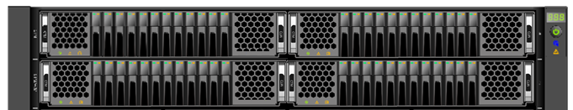
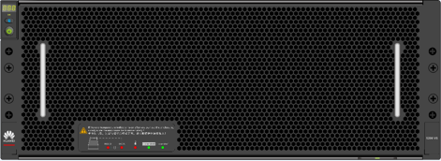
NAS HPC Solution: Parallel High Performance, Storage and Compute Collaborative Scheduling, High-Density Hardware, and Data Tiering
HPC Application
Compute Farm(50000+)
Parallel high-performance client
Compatible with POSIX and MPI-IO: Meets the requirements of the high-performance compute application ecosystem and provides the MPI optimization library to contribute to the parallel compute community.
Parallel I/O for high performance: 10+ Gbit/s for a single client and 4+ Gbit/s for a single thread
Intelligent prefetch and local cache: Supports cross-file prefetch and local cache, and meets high-performance requirements of NDP.
Large-scale networking: Meets the requirements of over 10,000 compute nodes.
Collaborative scheduling of storage and compute resources
Huawei scheduler: service scheduling and data storage collaboration, data pre-loading to SSDs, and local cache
QoS load awareness: I/O monitoring and load distribution avoid scheduling based on compute capabilities and improve overall compute efficiency.
High-density customized hardware
All-flash Atlantic architecture: 5 U, 8 controllers, 80 disks, 70 Gbit/s IOPS per enclosure @ 1.6 million IOPS
High-density Pacific architecture: 5 U 120 disks, supporting online maintenance and providing a high ratio EC to ensure high disk rate.
Back-end network free: With the built-in switch module, the back-end network does not need to be deployed independently if the number of enclosures is less than 3.
Data tiering for cost reduction
Single view and multiple media pools: Ensure that the service view will not be changed and applications will not be affected by the change.
Traditional burst buffer free: The all-flash optimized file system simplifies the deployment of a single namespace and provides higher performance especially for metadata access.
I/O Libraries
Parallel
Serial
......
MPI-IO
POSIX
Login & Job Scheduler
Parallel File System Client
Front-end network
OceanStor 100D File
Rack1
Rackn
Rackn+1
Rackm
...
...
SSD Pool
HDD Pool
Back-end network

